Slide 1
Robotics and AI Department
Israa AL Bity

Slide 2

Installing the package arduino_robot_arm

Slide 3

Package Arduino robot arm
Add the “arduino_robot_arm” package to “src” folder :
$ cd ~/catkin_ws/src
$ sudo apt install git
$ git clone https://github.com/smart-methods/arduino_robot_arm
Install all the dependencies :
$ cd ~/catkin_ws
$ rosdep install --from-paths src --ignore-src -r -y
$ sudo apt-get install ros-melodic-moveit
$ sudo apt-get install ros-melodic-joint-state-publisher ros-melodic-joint-state-publisher-gui
$ sudo apt-get install ros-melodic-gazebo-ros-control joint-state-publisher
$ sudo apt-get install ros-melodic-ros-controllers ros-melodic-ros-control
Compile the package
$ catkin_make
JUST COPY (ctrl+c) and PASTE (ctrl+v) in Terminal

Slide 4
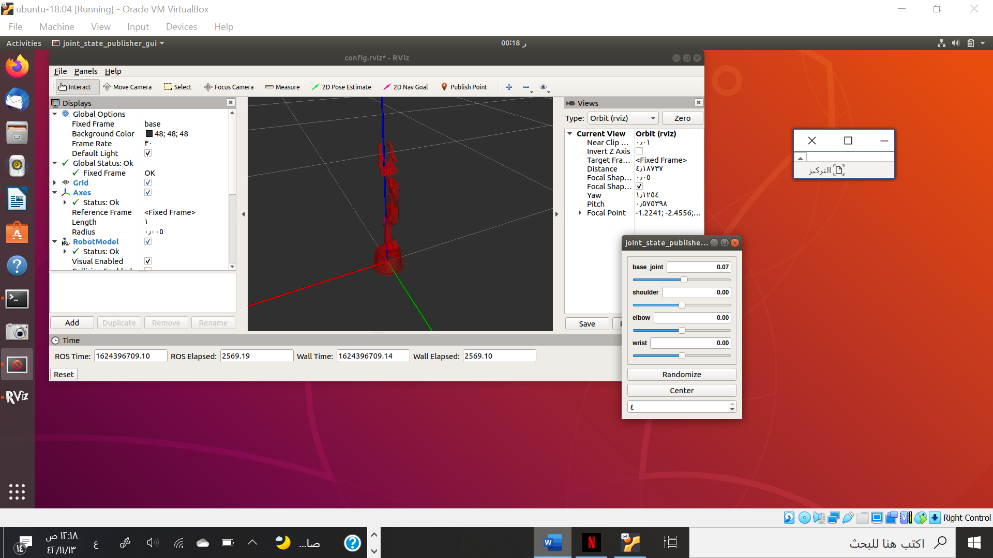
Package Arduino robot arm
$ roslaunch robot_arm_pkg check_motors.launch

Slide 5
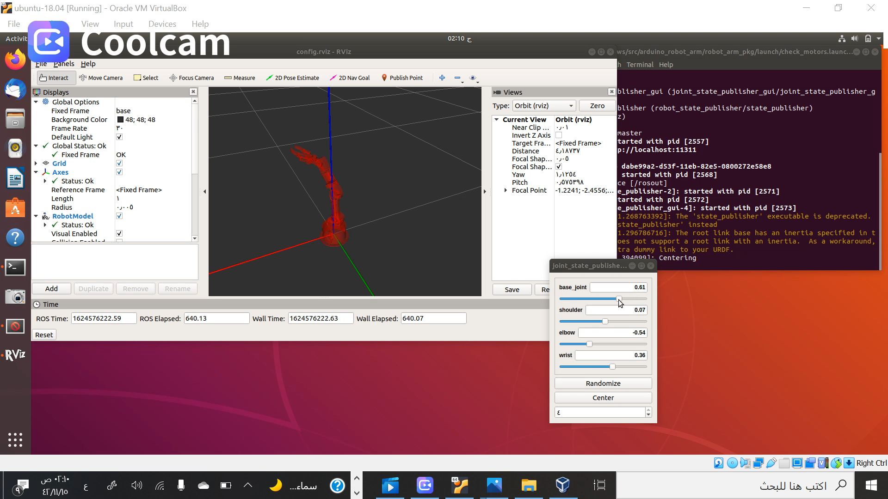
In this video, the Package arm is work

Slide 6
THANK YOU!
for giving me your time to watch the show.
I hope you enjoy.

